Slide 1
medCafe Tech Brief
Gail Hamilton and Jeff Hoyt
703-983-7855 • ghamilton@mitre.org
703-983-6241 • jchoyt@mitre.org
703-983-7043 • mgreer@mitre.org
MITRE Internal Information
For Limited External Release
Not approved for further distribution

Slide 2

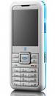



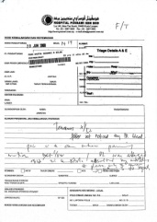
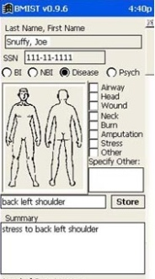


VA: The Current Workflow
Phone
Email
Fax
Vista
AHLTA
Outside Records
Has 15 minutes per patient
Notes:
They have, on average only 15 minutes to spend with each patient.
And have even less face time with a patient.
In this time they must
access the situation ,
to diagnose problem and
verify that old and new data confirms/ refutes this hypothesis
recommend treatment
To do this the doctor has to sift through a large amount of information, from various sources some of it not readily available.
These sources of information include:
VISTA – The system that they will currently be using to store patient records, or using as a messaging system
Email – generally Outlook
Fax – for any information that has been faxed from other clinicians or from outside sources
Phone – After a phone call, the physician has to write down the salient points of the call
And any scanned in records that are generically labeled “outside records”, and ,may include records from
AHLTA – The DoD medical system.
As a physician put it: “Everyday you need to search all these sources of information for data.”
Which leads to this…
All this information must be searched through and correlated in the physician’s head.
Which leads to this…

Slide 3
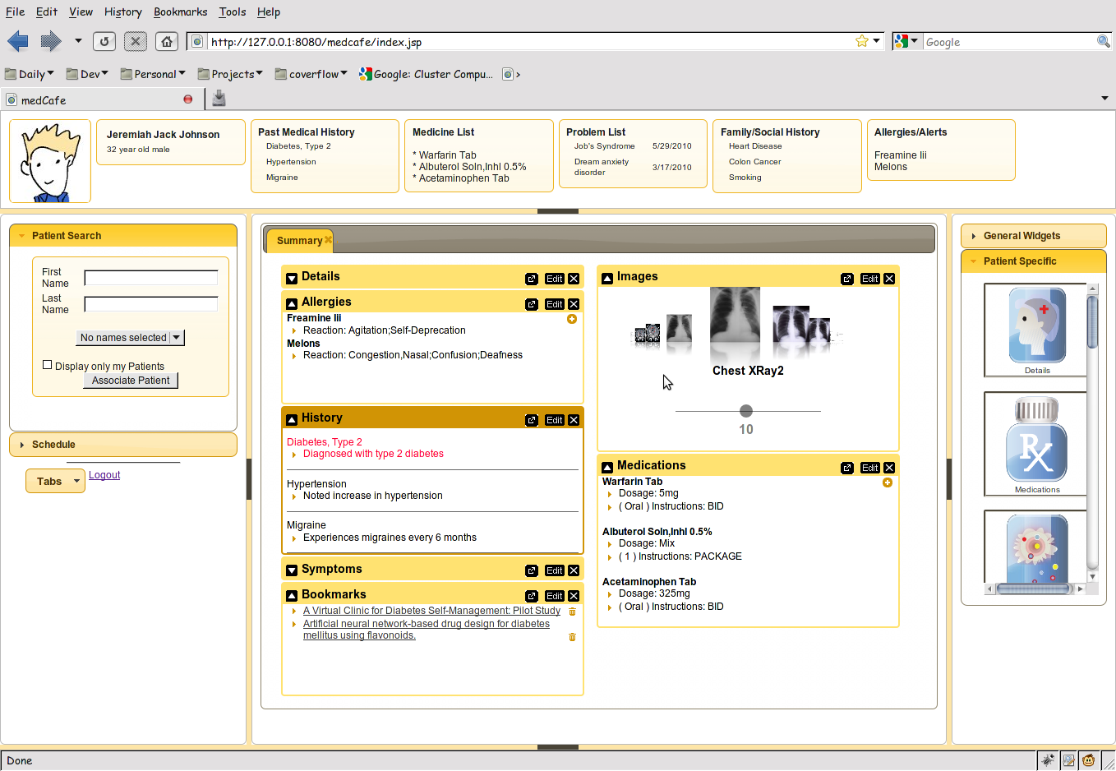
medCafe Interface
Top Pane: Coversheet containing commonly required patient data.
Left pane contains
Patient look up
and
scheduling functionality
Right hand pane contains list of
components that can be drag and dropped
into the center pane
Center pane contains composable patient record
Flexible 5 pane interface, adaptable to clinician’s needs. Panes can be hidden or shown.
Notes:
Framework overview:
5 major panes, North, South, etc,..
Can hide, show each pane.
Each pane can have multiple objects within it, such as tabs, widgets, sliders,treeviews etc,..

Slide 4
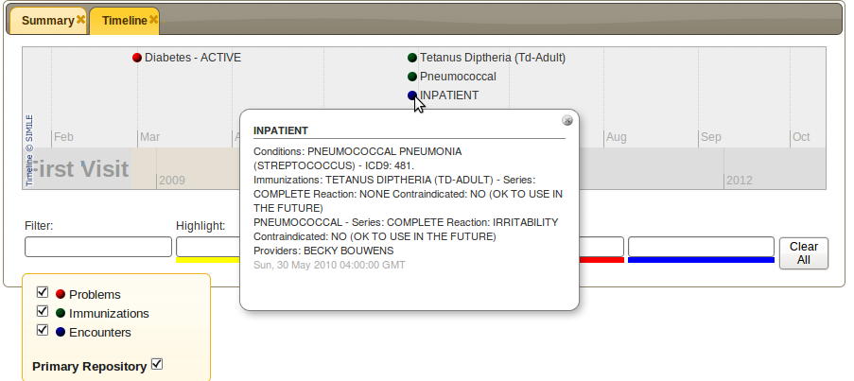
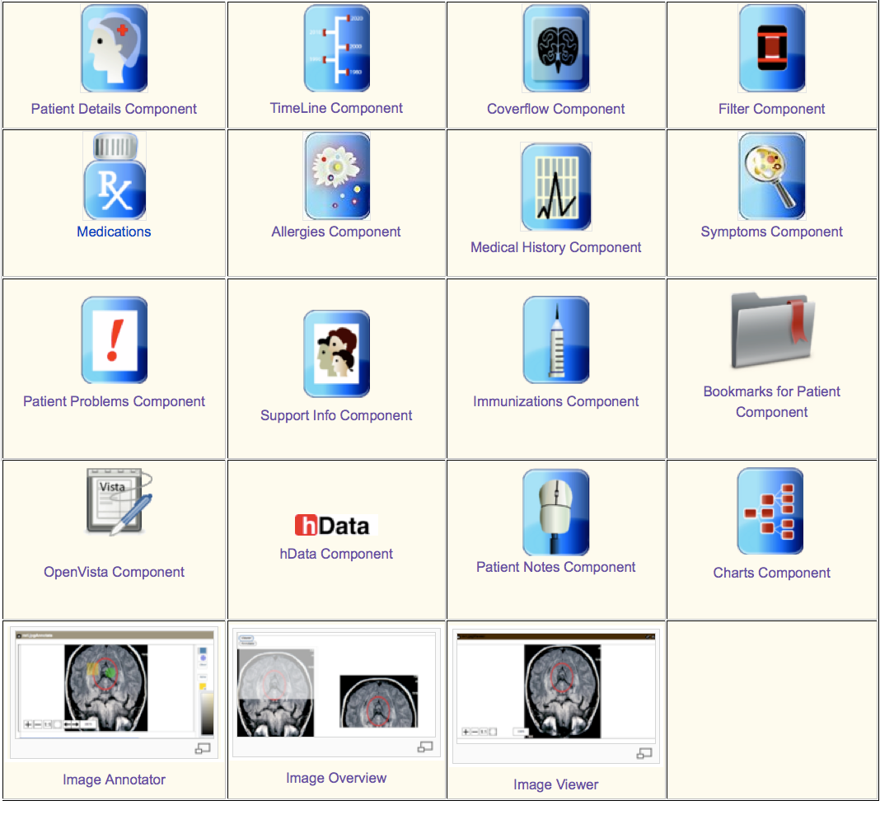
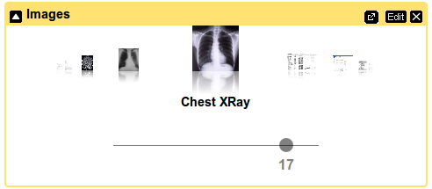
medCafe Components

Slide 5
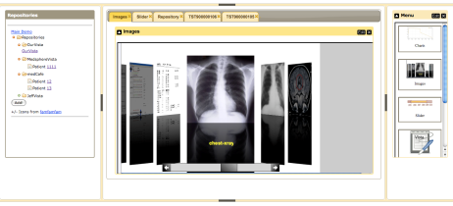





medCafe Architecture
Composable Framework
RESTful Web Services
Tabs
Coverflow
Date Slider
Image Viewers
Charts
Tomcat Web server
T
openVista
JAVA/ J2EE
Web Services
Additional
data servers
AJAX
medCafe Interface
Application server
Health-data server
medCafe architecture composed of 3 distinct, separable layers: front-end, application and data server.
Notes:
This shows the architecture of the framework that we have built.
We have three distinct pieces that make up the medcafe composable framework.

Slide 6
medCafe Feedback
Veteran’s Affairs Feedback
Peter Levin (CTO, Veterans Affairs)
”You have a very cool thing here”
Doug Rosendale (Dir. of Joint Interoperability Ventures within the Veterans Health Administration (VHA) Office of Health Information (OHI)),
“Wow – awesome,” “I love the componentized nature of this.” and “You had me at drop box…”
Dr. Nebeker, (Director, VA Informatics and Computing Infrastructure )
“last hope” (for Pensacola Pilot)
Jim Demetriades (Director, Emerging Health Technologies at Department of Veterans Affairs) and Nancy Wilck at Veterans Affairs
“We tried to do something similar 5 years ago”
Impacts
DoD/ VA Joint Presentation Layer Pilot site, Pensacola 1st July
Aligns well with Requirements for Joint Presentation Layer
Notes:
SMART: creating a “medical apps store” based on the iPhone/iPad model of substitutable applications running on a device or platform.
The approach could impact both the EHR industry and the federal regulatory and standards process, possibly within a relatively short period, i.e., 1-3 years, so we think it merits your attention.
ONC: Office of the National Coordinator for Health Information Technology

Slide 7
medCafe Impacts
Open Health Tools
“Open Health Tools (OHT) is dedicated to improving the health of people through the transformation of health information technologies (health IT).”¹
Rob Kolodner CTO Open Health Tools (former National coordinator for Health IT at VA)
Skip McGaughey, Executive Director OHT (CoFounder of Eclipse)
“You solved a lot of the really hard problems”
“There are many who want to work to solve the next generation of the UI [user-defined GUIs], which you've already thought through most of”
Impacts (from OHT meeting Feb. 24th)
Provide a capability that's currently missing from Open Health Tool's suite of tools
“When can we get this?”
¹http://www.openhealthtools.org/
Notes:
SMART: creating a “medical apps store” based on the iPhone/iPad model of substitutable applications running on a device or platform.
The approach could impact both the EHR industry and the federal regulatory and standards process, possibly within a relatively short period, i.e., 1-3 years, so we think it merits your attention.
ONC: Office of the National Coordinator for Health Information Technology

